Slide 1

NUS-ISS · ISY5004 CAPSTONE
Lumina
Your best photos, found for you.
Agustinus Benyamin Prasetyo · Ong Qing Quan
AIS Group 40
Notes:
Hi, we're presenting Lumina. It's a photo curator: you give it a pile of photos from a trip or an event, and it hands back the best shot of each person at each moment, with a reason. The little bear is Lumi, our mascot. You'll see Lumi a lot today.

Slide 2

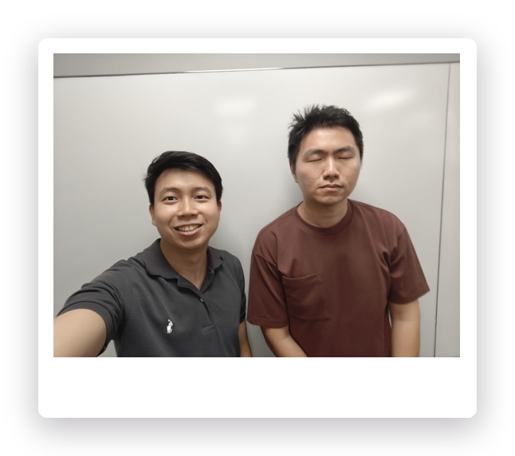
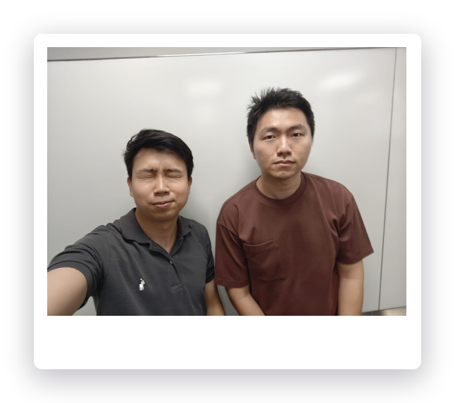
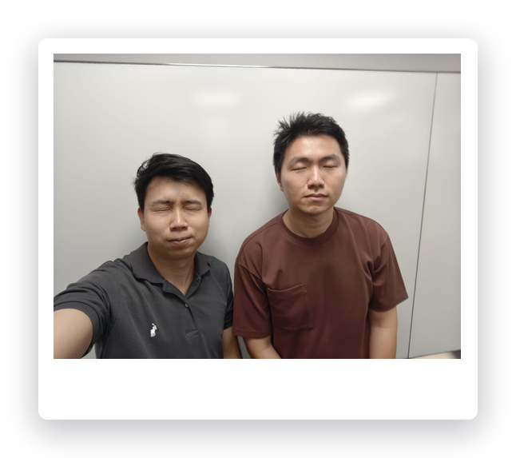
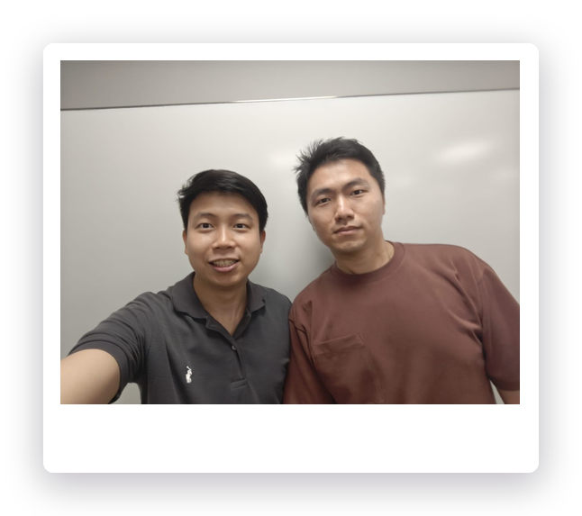
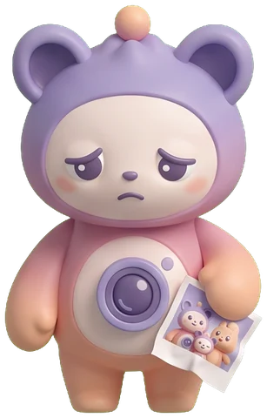
01 · THE PROBLEM
Hundreds of photos.
A handful worth keeping.
Redundancy
Effort
Judgement
Bursts and near-duplicates
Hours comparing, one by one
Which one is actually best?
One moment. Four shots.
Lumina
02
Notes:
Everyone has this problem. One dinner turns into forty photos: burst shots, someone blinking, the same pose four times. Picking the keeper is slow, and people aren't consistent about it. These four photos are one moment from our own test set. Two have closed eyes.

Slide 3
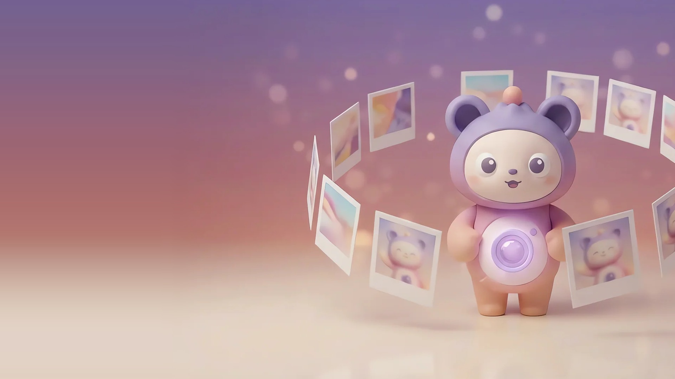
02 · THE IDEA
Meet Lumina
Drop in a whole trip. Lumina returns the best shot of everyone, at every moment, and tells you why.
Groups
Recognises
the moments
the people
Picks
Explains
the best shot
in plain words
Lumina
03
Notes:
Lumina does four things. It groups photos into moments, recognises who's in them, picks the best shot, and explains the pick in plain words. Everything runs on our own backend. Photos only go to a third party if you ask for Enhance or AI captions.

Slide 4

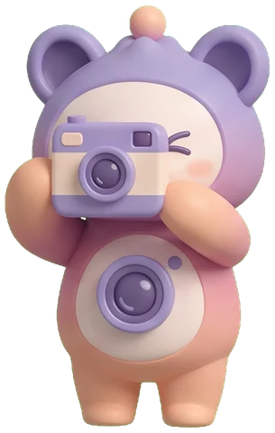
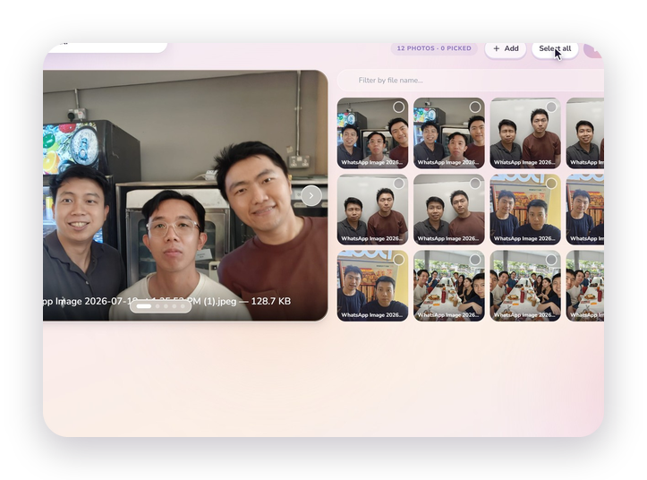
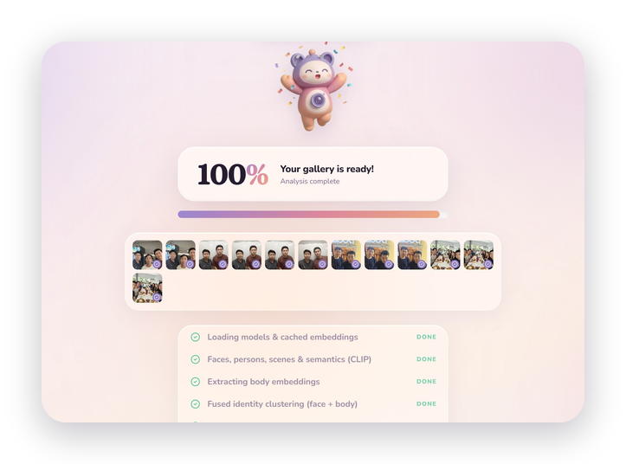
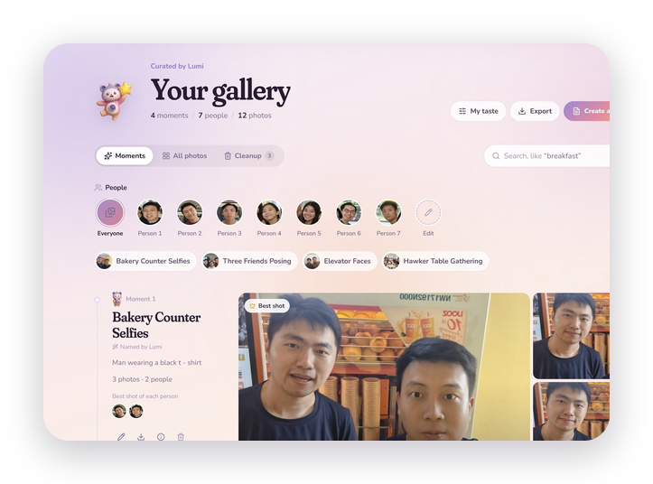
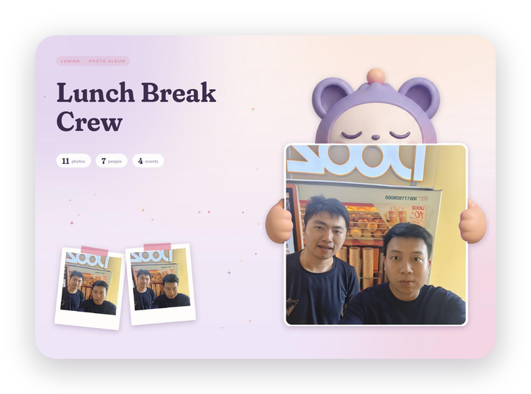
03 · THE EXPERIENCE
Four steps. Zero sorting.
1
Upload
2
Analyse
3
Browse
4
Keep
Up to 200 photos
Lumi narrates, live
Moments, people, best shots
Album, video or export
Lumina
04
Notes:
This is the whole flow. Upload a batch. Lumi narrates each stage while the models run. You land in a gallery organised by moment and person, with a best shot already picked. Then you keep it: a printable album, a short video, or a zip. [Live demo here if time allows: lumina-production-639d.up.railway.app]

Slide 5
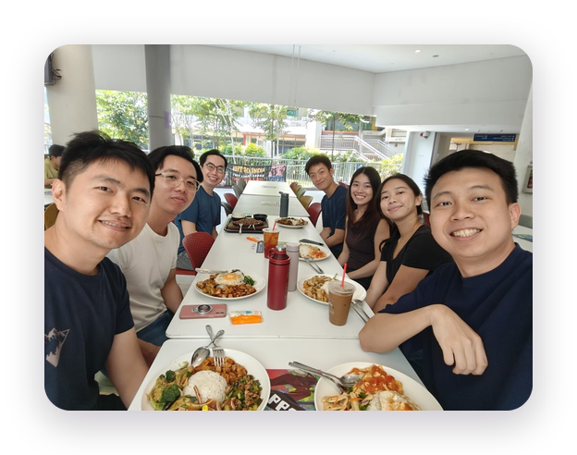
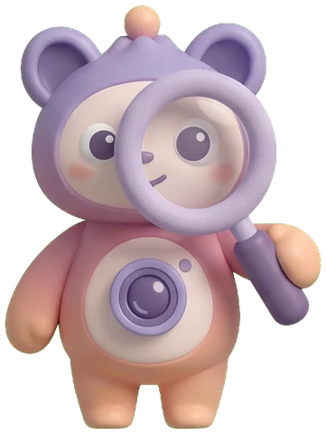
04 · UNDER THE HOOD
One photo, four ways of seeing
ArcFace
Faces · identity, quality
WHO
People
Face + body fusion
YOLOv8 + OSNet
Bodies · re-identification
WHEN
Moments
Scene + capture time
DINOv3
Scenes · event context
WHICH
Best shot
7 signals, plus a reason
Features cached by SHA-256
CLIP
Meaning · search, naming
Lumina
05
Notes:
Every photo is read four ways. ArcFace for faces, YOLOv8 plus OSNet for bodies, DINOv3 for the scene, and CLIP for meaning. Those feed three answers: who is in it, which moment it belongs to, and which shot is best. Moments use the scene plus the photo's capture time, so two similar rooms hours apart can still be told apart. Features are cached by the file's hash, so a photo is never analysed twice.

Slide 6
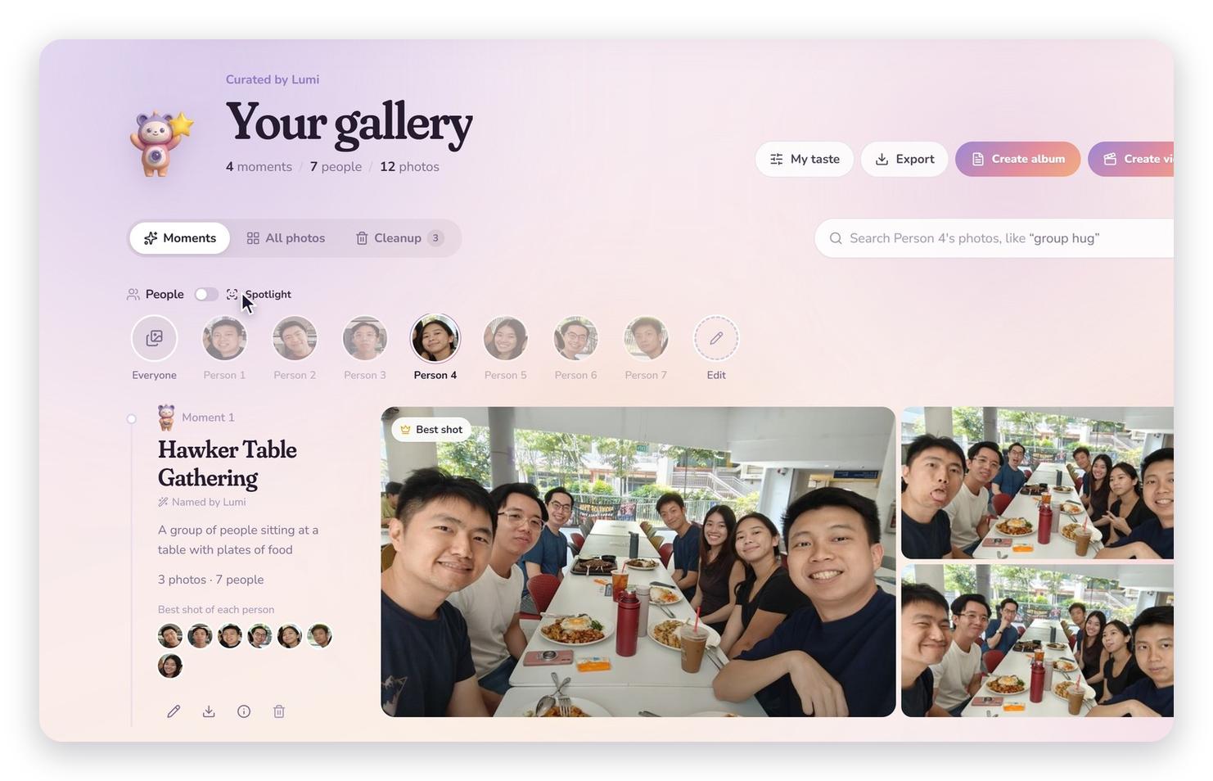
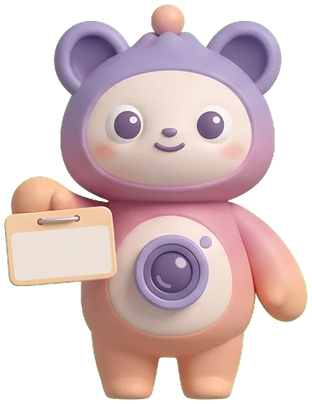
05 · PEOPLE
Recognised, even facing away
e = √α · face ⊕ √(1 − α) · body
Face leads when it's clear (α from 0.7 to 1)
Body fills in for turned-away shots
One person, tracked across every moment
Lumina
06
Notes:
Faces alone fail when someone turns away. So each detection gets a fused embedding: the face and body vectors are stacked, scaled by the square roots of alpha and one minus alpha, so the similarity is exactly an alpha-weighted blend of face and body similarity. Alpha comes from how confident and how large the face is, and it never drops below 0.7, so a visible face always leads. Agglomerative clustering then groups people across the whole set. On screen, Spotlight on one person highlights them in every group photo.

Slide 7

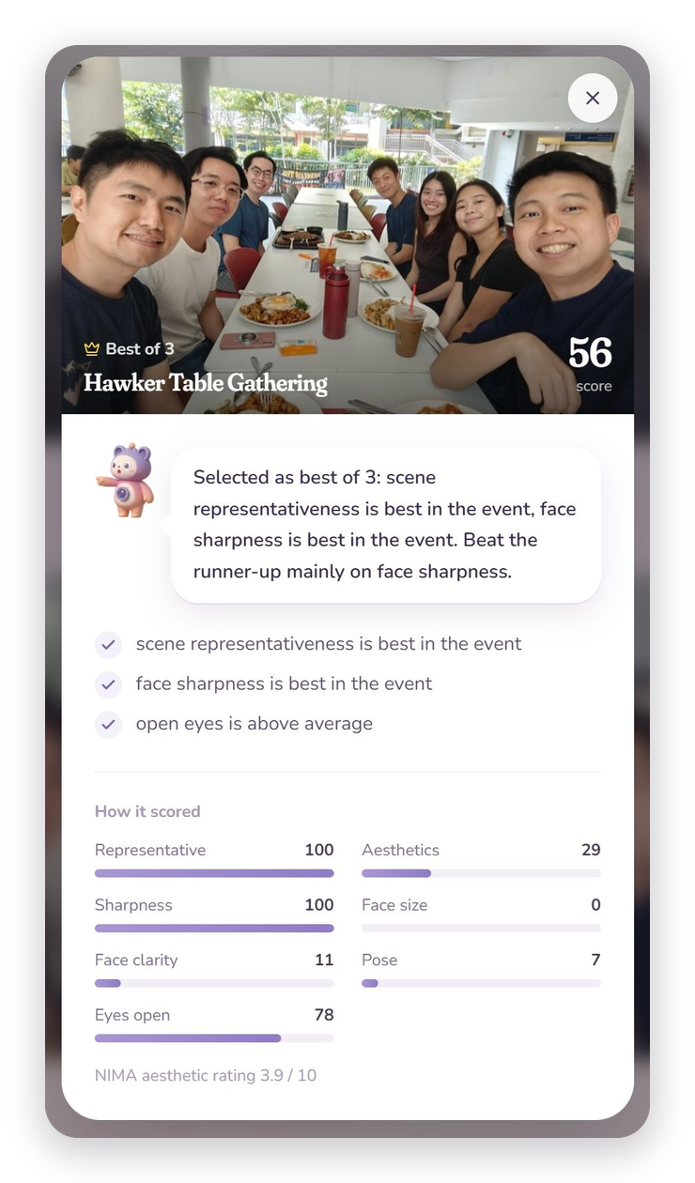
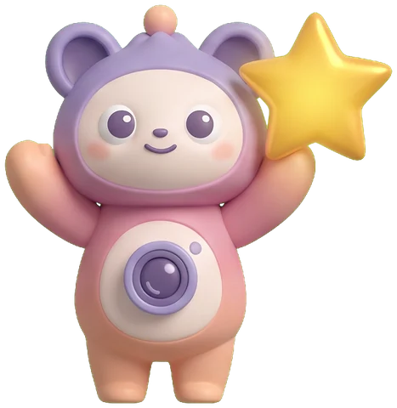
06 · CHOOSING
The best shot, and why
“Beat the runner-up mainly on face sharpness.”
Seven signals, one score
A blink never beats an open-eyes shot. Tiny gaps in a burst can't decide it.
Lumina
07
Notes:
Within each moment, seven signals are combined: how representative the photo is of the scene, NIMA aesthetics, face sharpness, size, detection confidence, pose and open eyes. Normalisation has a floor, so a tiny difference inside a burst can't decide the winner. And there is one hard rule: a photo with a blink always ranks below any open-eyes alternative. The winner comes with an explanation generated from the signal differences, for example 'beat the runner-up mainly on face sharpness'. Users can see the full breakdown.

Slide 8
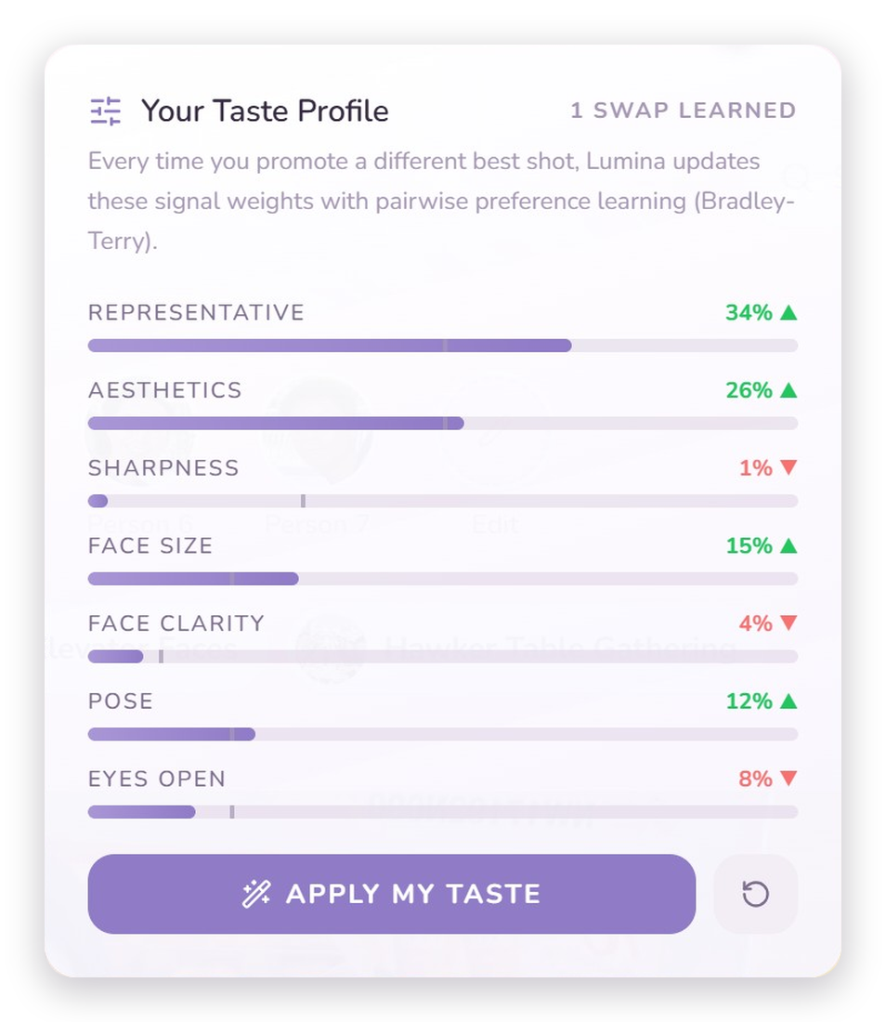

07 · PERSONAL
It learns your taste
01
02
03
You swap
→
It compares
→
It adapts
Choose a different best shot
Bradley–Terry update on 7 signals
Your weights re-rank every set
1 step
per swap, pulled back toward
the defaults so noise can't win
Lumina
08
Notes:
When you swap in a photo you prefer, that's a pairwise signal: this one beats that one. We take one Bradley-Terry gradient step on the difference in signal vectors, pulled back toward the defaults, so a few noisy swaps can't overwrite the ranker. The profile shows your learned weights against the defaults. We tested this with real people, which is two slides from now.

Slide 9
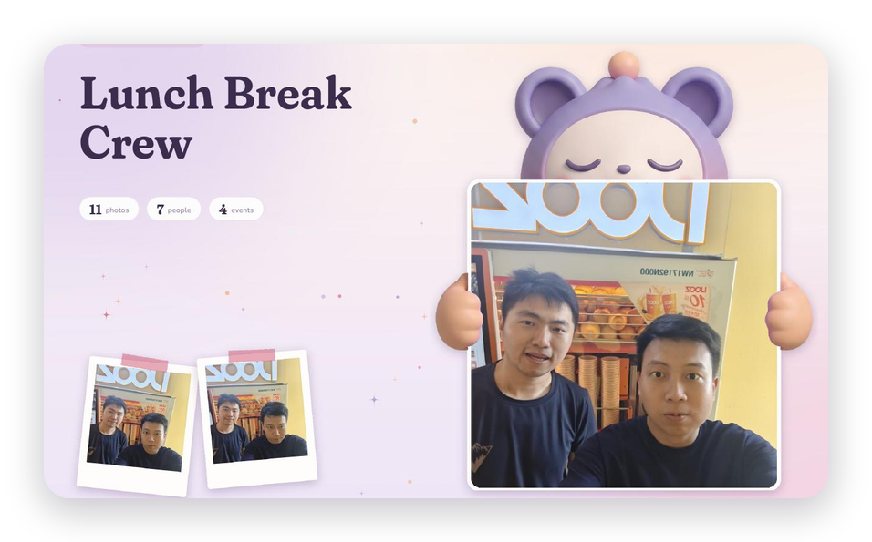
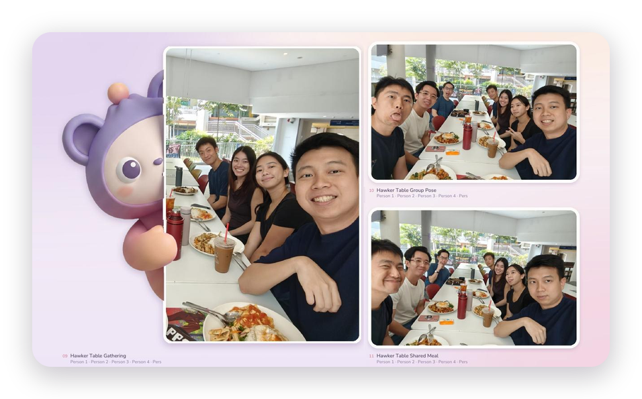
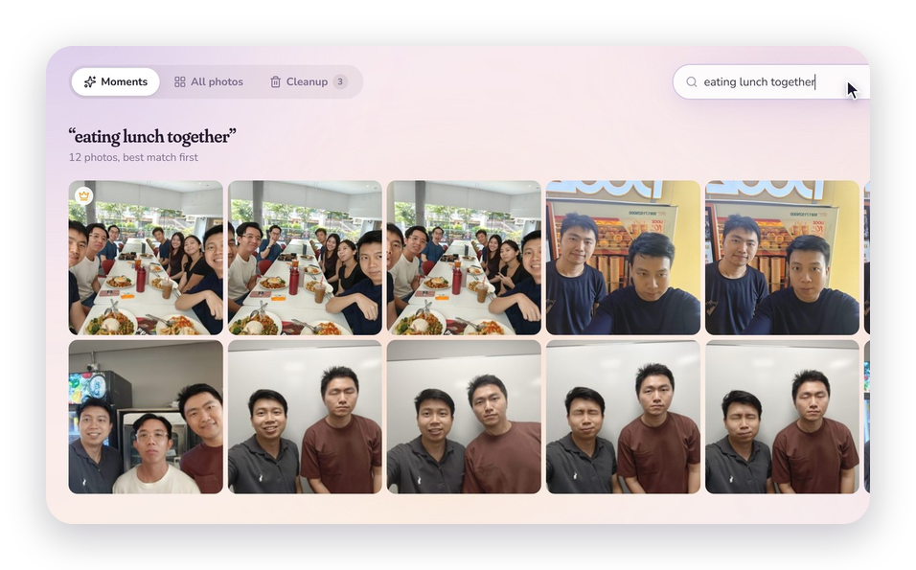
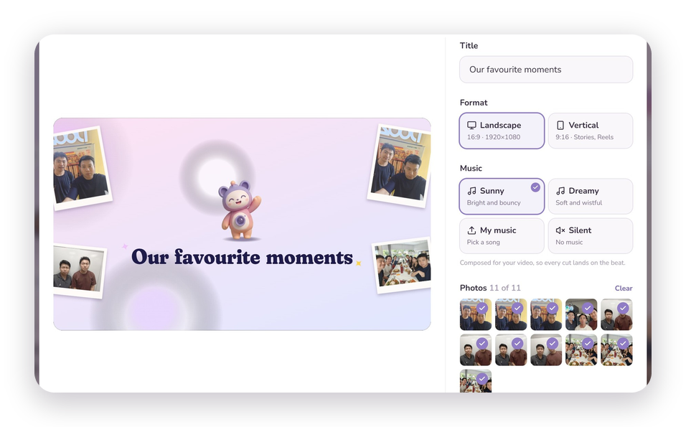
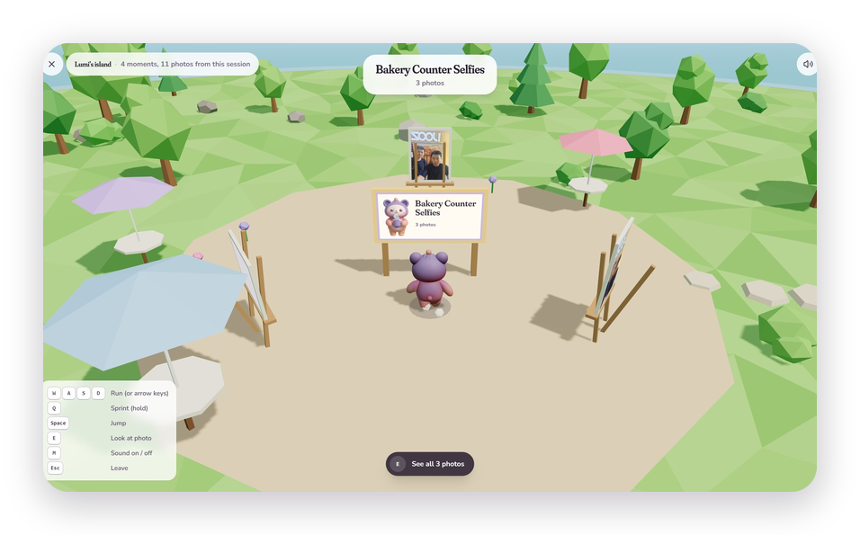
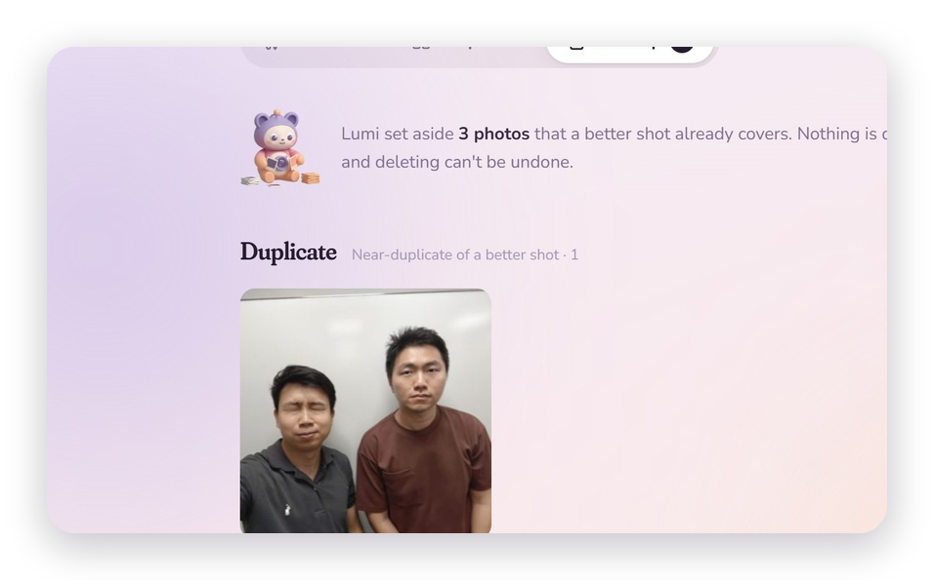
08 · BEYOND CURATION
Then make something with it
Printable album
Lumi holds your photos
Search in plain words
1080p video, cut to the beat
Walk your memories in 3D
Cleanup: duplicates, blinks
Lumina
09
Notes:
Once the curation is done, you can make something. A printable PDF album where Lumi holds your photos, CLIP search in plain words like 'eating lunch together', a 1080p video cut to the beat, a small 3D island where Lumi walks among your moments, and Cleanup, which sets aside duplicates, blinks and blurry shots with a reason and deletes nothing until you confirm.

Slide 10
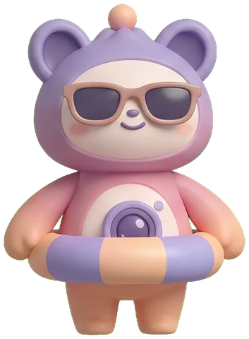

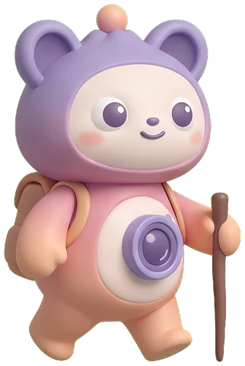

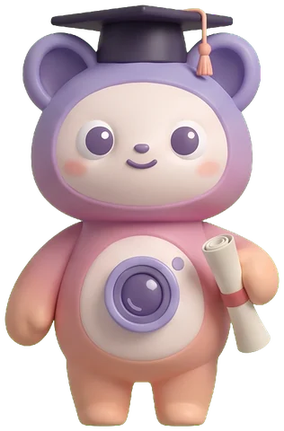
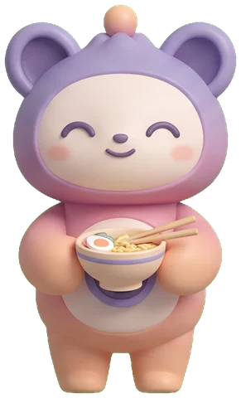
09 · PERSONAL TOUCH
Lumi dresses for your photos
CLIP names each moment. Lumi picks the outfit.
Beach
Birthday
Hiking
Wedding
Graduation
Dinner
30
4
poses
outfits, one recolour each
Lumina
10
Notes:
Lumi is our personal touch. Each moment is labelled zero-shot with CLIP, and that label chooses Lumi's outfit: sunglasses for the beach, a party hat for a birthday. The same mapping is used in the gallery, the album and the video. All 30 poses were generated once, offline, under a hard spending cap. The whole mascot cost about $2.60. Outfits are colour matrices, not extra artwork.

Slide 11

10 · PROGRESS
From baseline to product
SEMESTER 1
NOW
Fixed weights
→
Learns your taste
Re-runs everything
→
SHA-256 feature cache
Black-box picks
→
Plain-word reasons
No search
→
CLIP text search
One pick per group
→
Quality · Balanced · Diverse
Body-only identity
→
Face + body fusion
Lumina
11
Notes:
Our Semester 1 report listed six limitations. Each one is now addressed: fixed weights became preference learning; full recomputation became a hash-keyed feature cache; black-box picks now come with reasons; we added CLIP search; MMR gives Quality, Balanced and Diverse selection; and identity moved from body-only HDBSCAN to face-plus-body fusion.

Slide 12
11 · RESULTS
Does it work?
0.985
0/526
3 → 0
43×
event agreement (ARI),
vs 0.549 in Semester 1
same-photo face pairs
merged into one person
closed-eye winners once
a blink always loses
faster cached re-run,
82 s → 1.9 s
Change one part of the ranker: how many of 16 winners change? (higher = matters more)
Centrality and sharpness move the pick.
Without the blink rule, 3 winners have closed eyes. Pose, face size and ±20% weight changes move none.
Lumina
12
Notes:
Results on 55 of our own photos in 20 occasions. Events: the label-free threshold reaches an ARI of 0.985 against our grouping, versus 0.549 with the Semester 1 features. People: 526 pairs of faces share a photo, so they cannot be the same person, and clustering merges none of them. The blink rule takes closed-eye winners from 3 to 0. A cached re-run is 43 times faster, 82 seconds down to 1.9. The chart changes one part of the ranker at a time: NIMA alone changes 12 of 16 winners, centrality and sharpness 4 each, and pose, face size or a 20 percent weight change move none. Caveat: one private set, so we read these as indicative.

Slide 13
12 · HUMAN STUDY
What did people keep?
0.53
16/26
13/13
24/52
keep-one score,
chance is 0.50
repeat answers matched
the person's first pick
kept the group shot
Lumina ranked last
held-out matches after
learning, vs 26 before
13 people · 16 occasions · 234 picks · each person's weights learned separately
Above chance, not by much
Keep several, explain the rest
Next signal: everyone in frame
Two-photo questions carry the gain. Taste varies within and across people, so no one order fits everyone.
Cleanup sets frames aside with a stated reason (duplicate, blink, blur). Nothing is deleted until you say so.
Every tester kept the wide shot of the whole party. Sharpness and NIMA can't see that.
Lumina
13
Notes:
We asked 13 people to keep one photo per occasion, 234 picks in all. Lumina's order scores 0.53 where a random pick scores 0.50: above chance, but not by much. People aren't consistent either: shown the same occasion twice, 16 of 26 second answers matched the first. On one occasion all 13 kept the wide group shot that Lumina ranked last, because everyone was in it. And one learning pass didn't beat the defaults on held-out questions, 24 matches against 26. So we keep several shots, explain any we set aside, and the next signal to add is who is in the frame.

Slide 14
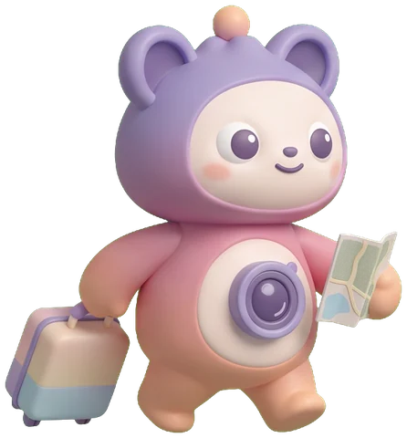
13 · REFLECTION
Limits, and what's next
Limits
Next
55 private photos, no identity labels
One learning pass didn't beat defaults
CPU hosting: slow first load
200 photos per batch
Enhance needs a paid API
Count who's in the frame
Keep several shots, show why
Bigger study, more repeat questions
Labelled public album benchmark
Ask the user on unsure faces
Lumina
14
Notes:
Honest limits: our test set is 55 private photos with no identity labels, one learning pass didn't beat the defaults, the free CPU hosting makes the first load slow, and batches are capped at 200. Next, we'd count who is in the frame, keep several shots with reasons rather than one keeper, run a bigger study with more repeat questions, benchmark on a labelled public album, and ask the user about faces the model is unsure of.

Slide 15

CONCLUSION
Less scrolling.
More remembering.
01
Finds the people and the moments.
02
Picks the best shot, and says why.
03
Learns you, then makes something to keep.
Notes:
To wrap up: Lumina finds the people and the moments, picks the best shot and explains it, learns your taste, and turns the result into something you keep. Less time scrolling, more time remembering.

Slide 16

Questions?
Thank you, from us and from Lumi.
Try it
lumina-production-639d.up.railway.app
Notes:
Thank you. We're happy to take questions. Likely ones: why agglomerative over HDBSCAN for identity (fusion space and stability on small sets); how the explanation is generated (signal deltas vs runner-up); privacy (all inference on our backend; third-party only for Enhance/captions); why a mascot (makes waiting and results feel friendly, and it's reused consistently across app, album and video).

